Slide 1
Discrete Mathematics (CSC 1204)
9.2 Applications of Trees
9.3 Tree Traversal

Slide 2
Common Uses of Trees
Manipulate hierarchical data
Make information easy to search
Manipulate sorted lists of data
As a workflow for compositing digital images for visual effects
Routing Algorithms

Slide 3
9.2 Applications of Trees
Three problems can be studied using trees –
How should items in a list be stored so that an item can be easily located?
What series of decisions should be made to find an object with a certain property in a collection of objects of a certain type?
How should a set of characters be efficiently coded by bit strings?

Slide 4
9.2 Applications of Trees
Binary search tree
A simple data structure for sorted lists
Decision tree
A rooted tree where each vertex represents a possible outcome of a decision and the leaves represent the possible solutions
Minimum comparisons in sorting algorithms
Prefix code
A code that has the property that the code of a character is never a prefix of the code of another character
Huffman coding

Slide 5
Binary Search Tree (BST)
A binary tree in which each child of a vertex is designated as a right or left child.
No two vertex has more than one right child or left child, and each vertex is labeled with a key, which is one of the items.
Vertices are assigned keys so that the key of a vertex is both larger than the keys of all vertices in its left subtree and smaller than the keys of all vertices in its right subtree.

Slide 6
Binary Search Tree (BST)
Binary Search Tree (BST): A binary tree in which the vertices are labeled with items so that a label of a vertex is greater than the labels of all vertices in the left subtree of this vertex and is less than the labels of all vertices in the right subtree of this vertex.

Slide 7
Binary Search Tree: Example
Items are stored at individual tree nodes.
We arrange for the tree to always obey this invariant:
For every item x,
Every node in x’s left subtree is less than x.
Every node in x’s right subtree is greater than x.
7
3
12
1
5
9
15
0
2
8
11

Slide 8
Is this a BST?
5
4
3
2
7
8
9
No, this is NOT a BST. Why?

Slide 9
Binary Search Tree
Binary search tree construction Algorithm
Start with a tree containing just one vertex (the root).
Let v = the root.
To add a new item a, do the following until stop:
If a< v:
If v has a left child, then v = left child of v(move to the left)
Else add a new left child to v with this item as its key.
Stop.
If a> v:
If v has a right child, then v= right child of v(move to the right).
Else add a new right child to v with this item as its key.
Stop.

Slide 10
Construction of BST
Example: Construct/Form a BST using the numbers below.
5 9 8 1 2 4 6 10

Slide 11
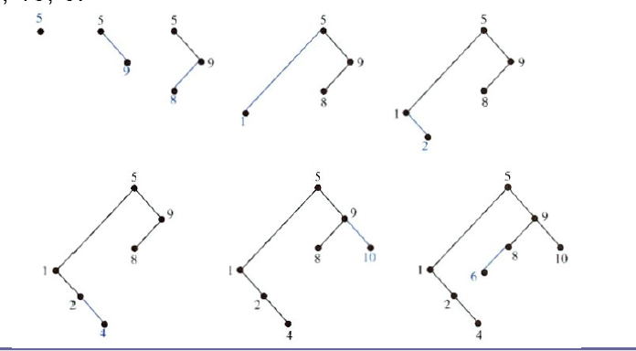
Construction of BST
5 9 8 1 2 4 6 10

Slide 12
Example 1
EXAMPLE 1: Form a binary search tree for the words mathematics, physics, geography, zoology, meteorology, geology, psychology, and chemistry (using alphabetical order).

Slide 13
Solution of Example 1
Solution: Figure 1 displays the steps used to construct this binary search tree.
The word mathematics is the key of the root. Because physics comes after
mathematics (in alphabetical order), add a right child of the root with key
physics. Because geography comes before mathematics, add a left child of the
root with key geography. Next, add a right child of the vertex with key physics,
and assign it the key zoology, because zoology comes after mathematics and
after physics. Similarly, add a left child of the vertex with key physics and
assign this new vertex the key meteorology. Add a right child of the vertex
with key geography and assign this new vertex the key geology. Add a left
child of the vertex with key zoology and assign it the key psychology. Add a
left child of the vertex with key geography and assign it the key chemistry.
(The reader should work through all the comparisons needed at each step.)

Slide 14
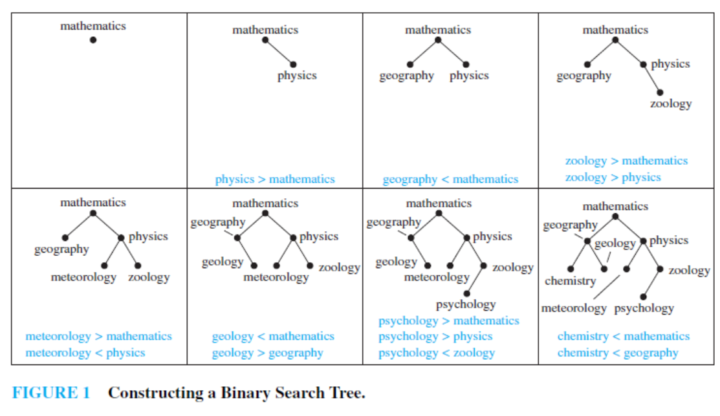
Solution of Example 1

Slide 15
Class Work
Exercise 1: Build a binary search tree for the words banana, peach, apple, pear, coconut, mango, and papaya using alphabetical order.
Exercise 5: Using alphabetical order, construct a binary search tree for the words in the sentence
“The quick brown fox jumps over the lazy dog.”

Slide 16
8.3 Tree Traversal
Tree traversal:
A listing of the vertices of a tree
Is a procedure that systematically visits every vertex of an ordered rooted tree

Slide 17
Traversal Algorithms
Procedures for systematically visiting every vertex of an ordered rooted tree are called traversal algorithms.
Three most commonly used traversal algorithms:
Preorder traversal
Inorder traversal
Postorder traversal

Slide 18
Preorder Traversal
DEFINITION: Let T be an ordered rooted tree with root r. If T consists only of r, then r is the preorder traversal of T . Otherwise, suppose that T₁, T₂, . . . , T_{n} are the subtrees at r from left to right in T .
The preorder traversal begins by visiting r. It continues by traversing T₁ in preorder, then T₂ in preorder, and so on, until T_{n} is traversed in preorder.

Slide 19
Preorder Traversal
Step 1: Visit the root r
Step 2: Visit T₁ in preorder
r
Step 3: Visit T₂ in preorder
T₁
T₂
T_{n}
Step n+1: Visit T_{n} in preorder

Slide 21
Example 2
In which order does a preorder traversal visit the vertices in the ordered rooted tree T shown in Figure 3?
Solution:
The steps of the preorder traversal of T are shown in Figure 4.
We traverse T in preorder by first listing the root a,
followed by the preorder list of the subtree with root b, the
preorder list of the subtree with root c (which is just c) and
the preorder list of the subtree with root d.

Slide 22
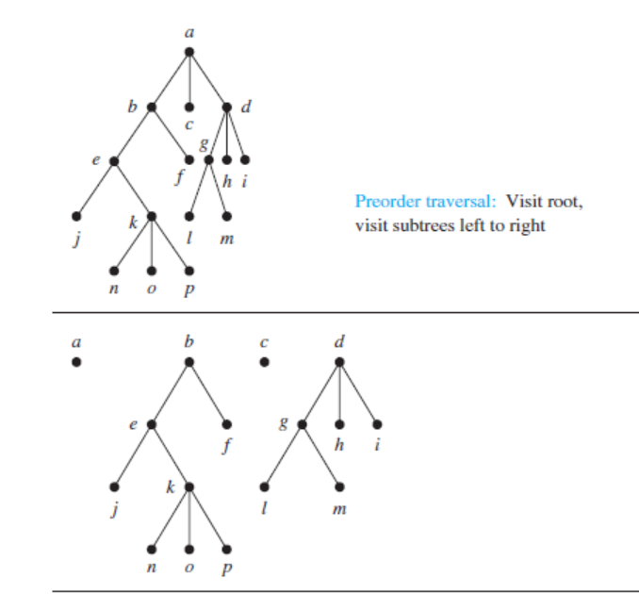
Example 2
Figure 3

Slide 23
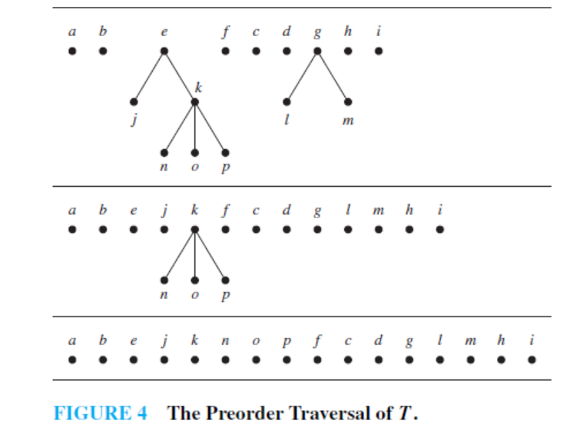
Example 2

Slide 24
Class Work: Example Of Preorder Traversal
M
A
Y
E
J
R
H
P
Q
T

Slide 25
Example Of Preorder Traversal
M
A
Y
E
J
R
H
P
Q
T
M
A
J
Y
R
H
P
Q
T
E

Slide 26
Inorder traversal
DEFINITION 2: Let T be an ordered rooted tree with root r. If T consists only of r, then r is the inorder traversal of T. Otherwise, suppose that T₁, T₂, . . . , T_{n} are the subtrees at r from left to right.
The inorder traversal begins by traversing T₁ in inorder, then visiting r. It continues by traversing T₂ in inorder, then T₃ in inorder,..., and ﬁnally T_{n} in inorder.

Slide 27
Inorder Traversal
Step 1: Visit T₁ in inorder
Step 2: Visit the root r
r
Step 3: Visit T₂ in inorder
Step n+1: Visit T_{n} in inorder
T₁
T₂
T_{n}

Slide 29
Example of Inorder Traversal
EXAMPLE 3: In which order does an inorder traversal visit the vertices of the ordered rooted tree T in Figure 3?
Solution: The steps of the inorder traversal of the ordered
rooted tree T are shown in Figure 6. The inorder traversal
begins with an inorder traversal of the subtree with root b,
the root a, the inorder listing of the subtree with root c,
which is just c, and the inorder listing of the subtree with
root d.

Slide 30
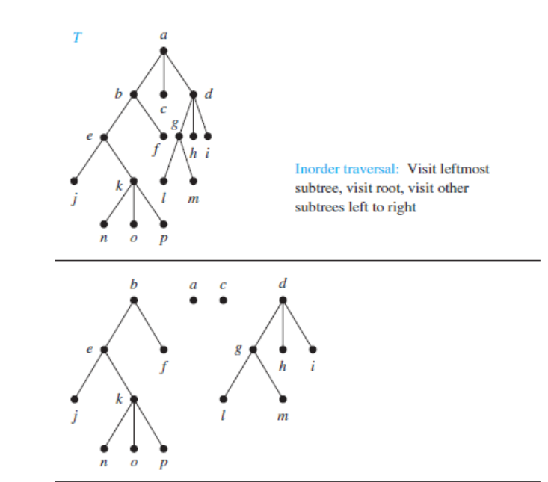
Example of Inorder Traversal
Figure 3 ➔
Figure 6 ➔

Slide 31
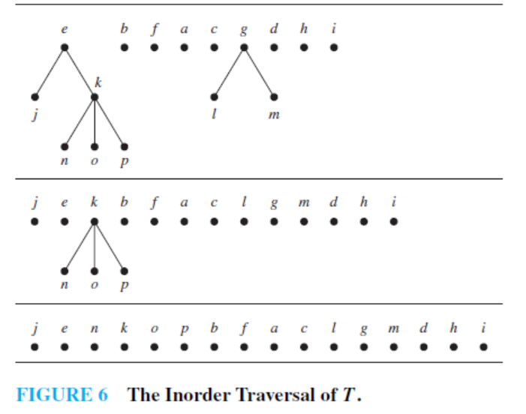
Example of Inorder Traversal
Figure 3

Slide 32
Postorder Traversal
DEFINITION 3: Let T be an ordered rooted tree with root r. If T consists only of r, then r is the postorder traversal of T . Otherwise, suppose that T₁, T₂, . . . , T_{n} are the subtrees at r from left to right.
The postorder traversal begins by traversing T₁ in postorder, then T₂ in postorder, . . . , then T_{n} in postorder, and ends by visiting r.

Slide 33
Postorder Traversal
Step 1: Visit T₁ in postorder
Step 2: Visit T₂ in postorder
r
Step n: Visit T_{n} in postorder
Step n+1: Visit r
T₁
T₂
T_{n}

Slide 34
EXAMPLE 4
EXAMPLE 4 : In which order does a postorder traversal visit the vertices of the ordered rooted tree T shown in Figure 3?
Solution: The steps of the postorder traversal of the ordered rooted tree T are shown in Figure 8. The postorder traversal
begins with the postorder traversal of the subtree with
root b, the postorder traversal of the subtree with root c,
which is just c, the postorder traversal of the subtree with
root d, followed by the root a.

Slide 35
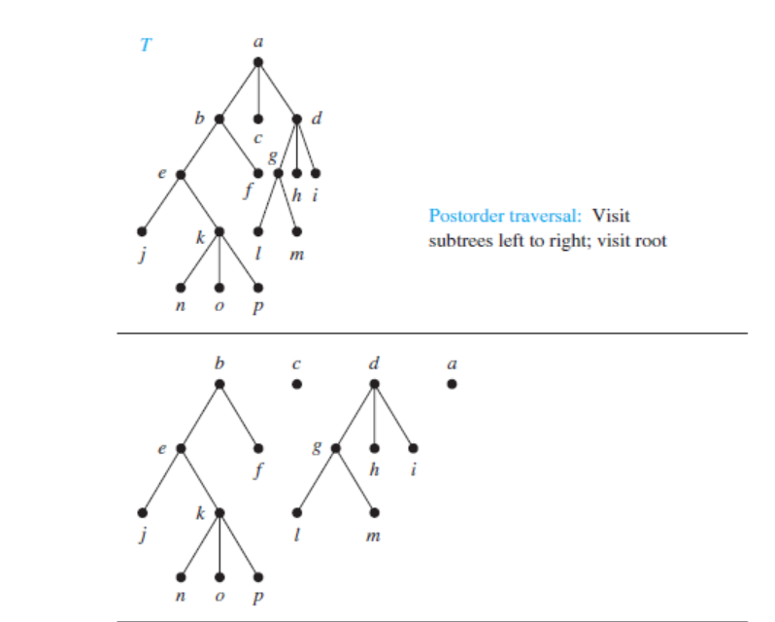
EXAMPLE 4

Slide 36
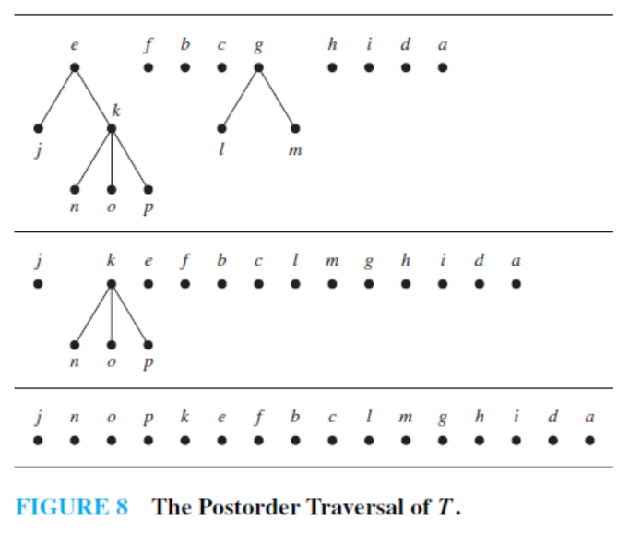
EXAMPLE 4

Slide 37
Tree Traversal: Preorder, Inorder, Postorder
Class Work
a
d
b
c
e
g
i
f
h
j
k
l
m
n
o
p

Slide 38
Tree Traversal: Preorder, Inorder, Postorder
Answers:
Preorder: a b e j k n o p f c d g l m h i
Inorder: j e n k o p b f a c l g m d h i
Postorder: j n o p k e f b c l m g h i d a

Slide 39
Infix, Prefix and Postfix Notations
Complicated expressions, such as compound propositions, combinations of sets, and arithmetic expressions can be represented using ordered rooted tree.
For instance, consider the representation of an arithmetic expression involving the operators + (addition), – (subtraction), * (multiplication),
/ (division), and (exponentiation).

Slide 40
Infix, Prefix and Postfix Notations
Complicated arithmetic expressions can be represented by an ordered rooted tree
Internal vertices represent operators
Leaves represent operands
Parentheses indicate the order of the operations
Build the tree bottom-up
Construct smaller subtrees
Incorporate the smaller subtrees as part of larger subtrees

Slide 41
Infix, Prefix and Postfix Notations
Prefix notation: The form of an expression obtained from a preorder traversal of the tree representing this expression.
Infix notation: The form of an expression obtained from an inorder traversal of the binary tree representing this expression.
Postfix notation: The form of an expression obtained from a postorder traversal of the tree representing this expression.

Slide 43
Infix, Prefix and Postfix Notations
Example 5: What is the ordered rooted tree that represents the expression ((x + y) 2 ) + ((x – 4) / 3) ?
Solution:
Figure 10

Slide 44
Infix, Prefix and Postfix Notations
Example 6: What is the prefix form for
((x + y) 2 ) + ((x – 4) / 3) ?
Solution: We obtain the prefix form for this expression by traversing the binary tree that represents it. This produces + + x y 2 / – x 4 3

Slide 45
Infix, Prefix and Postfix Notations
Example 8: What is the postfix form for
( (x + y) 2 ) + ((x – 4) / 3) ?
Solution: The postfix form of the expression is obtained by carrying out a postorder traversal of the binary tree (see slide # 43, Figure 10) for this expression.
This produces the postfix expression: x y + 2 x 4 – 3 / +

Slide 46
Evaluating a Prefix Expression
In an prefix expression, a binary operator precedes its two operands
The expression is evaluated from right to left
Look for the first operator from the right
Perform the corresponding operation with that operator with the two operands immediately to its right

Slide 47
Evaluating a Prefix Expression
Example 7: What is the value of the prefix expression + – * 2 3 5 / 2 3 4 ?
Solution: The steps used to evaluate this expression by working right to left, and performing operations using the operands on the right, are shown in
Figure 12.
The value of this expression is 3.

Slide 48
Evaluating a Postfix Expression
In an postfix expression, a binary operator follows its two operands
The expression is evaluated from left to right
Look for the first operator from the left
Perform the corresponding operation with that operator with the two operands immediately to its left

Slide 49
Evaluating a Postfix Expression
Example 9: What is the value of the postfix expression 7 2 3 * – 4 9 3 / + ?
Solution: The steps used to evaluate this expression by starting at the left and carrying out operations when two operands are followed by an operator are shown in Figure 13.
The value of this expression is 4.

Slide 50
Evaluating Prefix & Postfix Expression

Slide 51
Class Work
What is the value of the prefix expression
+ / + 2 2 2 / – 3 2 + 1 0 ?

Slide 52
Solution
+ / + 2 2 2 / – 3 2 + 1 0
+ / + 2 2 2 / – 3 2 1
+ / + 2 2 2 / 1 1
+ / + 2 2 2 1
+ / 4 2 1
+ 2 1
3

Slide 53
Class Work
What is the value of the postfix expression
2 2 + 2 / 3 2 – 1 0 + / + ?

Slide 54
Solution
2 2 + 2 / 3 2 – 1 0 + / +
4 2 / 3 2 – 1 0 + / +
2 3 2 – 1 0 + / +
2 1 1 0 + / +
2 1 1 / +
2 1 +
3

Slide 55
Practice @ Home
Relevant odd-numbered exercises
Exercises: 7, 9 , 11, 13, 15, 17, 23, 24,25

